Slide 1
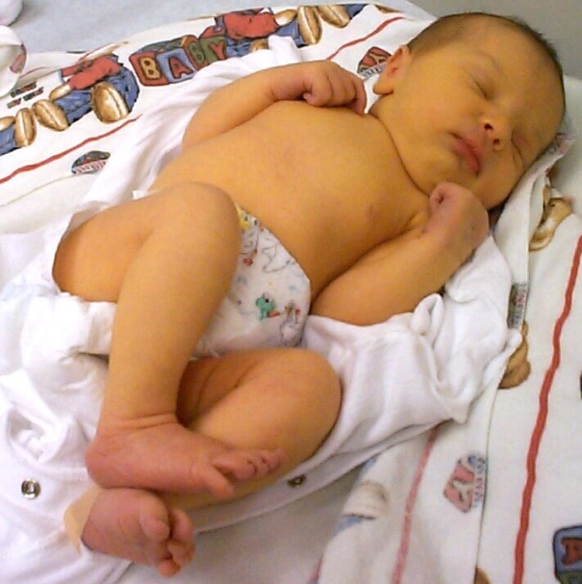
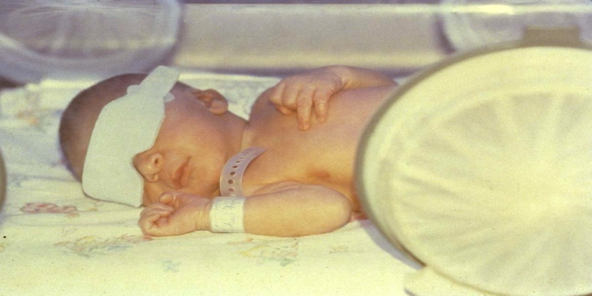
Neonatal Jaundice and Hyperbilirubinemia
DEPARTEMENT OF PEDIATRICS AND CHILD HEALTH
By: Dr. Mesfin.W(Assistant professor of Pediatrics and child health)
June @2024
Notes:
Jaundice and Hyperbilirubinemia in the Newborn

Slide 2
Outline
Definition of clinical terminologies
Basic physiology of Bilirubin metabolism
Etiologies of Hyperbilirubinemia & Types
General Approach
Principles of management
Long term outcome

Slide 3
Introduction
Common and in most cases benign problem
Untreated severe indirect hyperbilirubinemia is potentially neurotoxic.
Severe conjugated direct hyperbilirubinemia signifies a serious hepatic or systemic illness but is not neurotoxic.
Observed in 60% and 80% of term & preterm neonates in the 1st week respectively.
Diagnosed when total bilirubin >2mg/dl

Slide 4
Definitions
Hyperbilirubinemia is an increase in the serum bilirubin manifested clinically by jaundice
Jaundice is a yellowish discoloration of the skin, sclera and mucous membranes which is rarely perceptible until the serum bilirubin level exceeds 5-7.0 mg/dl.
Notes:
Visible form of bilirubinemia
Adult sclera >2mg / dl
Newborn skin >5 mg / dl

Slide 5
Cont..
Bilirubin- degradation product of heme
  Unconjugated (indirect acting)
  Conjugated (direct acting)
Acute Bilirubin Encephalopathy: clinical nervous system manifestations caused by bilirubin toxicity
Kernicterus: chronic, permanent clinical sequelae of bilirubin toxicity

Slide 6
Neonatal bilirubin metabolism
Destruction RBCs---------Non RBC comp.
Hemoglobin Cytochrome
Myoglobin
Heme containing Globin HEME enzymes
-------------------Heme oxygenase
biliverdin
biliverdin reductase
bilirubin(ix alpha)

Slide 7
Neonatal bilirubin metabolism
Bilirubin(ix alpha)
Bilirubin(ix alpha+albumin)
. Ligandin(y-protein,z-protein) INSIDE
. Uridine diphosphate glucornyl LIVER
transferase
Bilirubin glucuronide(conjugated bilirubin or direct bilirubin)

Slide 8
BILLIRUBIN METABOLISM
The conjugated bilirubin will go to bowel with bile.
In adults due to the presence of E.coli and clostridium perfirngens most of the conjugated bilirubin is reduced to stercobilin w/c is not resorbed to circulation
B/c of the absence of the above bacteria there will be no reduction and due to the presence β-glucourinidase enzyme bilirubin will be unconjugated and resorbed back through entero-hepatic circulation and little amount go to kidneys to be excreted as urobilinogen.

Slide 9
unconjugated bilirubin
Non-polar and lipid-soluble
    So easily pass through lipid membrane to accumulate in the tissues
    Bind with albumin, not excreted
Can accumulate physiologically
But it is neurotoxic in infants at certain concentrations and under various conditions
WHY?
due to its hydrophobicity it can cross the blood-brain barrier and cause a type of mental retardation known as kernicterus

Slide 10
The toxic effects of elevated levels of unconjugated bilirubin in serum are increased by factors that
  reduce the retention of bilirubin in the circulation or
  by factors that increase the permeability of the blood-brain barrier or nerve cell membranes to bilirubin or
  increase the susceptibility of brain cells to its toxicity, such as asphyxia, prematurity, hyperosmolality, and infection.
Early feeding decreases whereas breast-feeding and dehydration increase serum levels of bilirubin

Slide 11
If bilirubin levels are judged to be too high, then phototherapy with UV light is used to convert it to a water soluble, non-toxic form
If necessary, exchange blood transfusion is used to remove excess bilirubin

Slide 12
Conjugated bilirubin
undergone conjugation in the liver cell microsome
polar, water-soluble
      Less toxic unless deconjugated
      Less affinity for albumin
Conjugated bilirubin is not neurotoxic but indicates a potentially serious disorder
Accumulation always pathologic

Slide 13
Etiology
Unconjugated hyperbilirubinemia may be caused/increased by any factor that:
1. Increases the load of bilirubin to be metabolized by the liver.
-hemolytic anemias, polycythemia, increased enterohepatic circulation, infection
2. Damages or reduces the activity of the transferase enzyme.
-genetic defect, hypoxia, infections, hypothermia, hypothyroidism

Slide 14
Etiology cont..
3. Competes for/blocks the transferase enzyme
-drugs and other substances requiring glucuronic acid conjugation for excretion
4. Leads to the absence/decrease in amount of the enzyme or reduction of bilirubin uptake by liver cells
-genetic deficiency, prematurity

Slide 15
Risk factors for unconjugated hyperbilirubinemia
Jaundice visible on the first day of life
A sibling with neonatal jaundice/anemia
Unrecognized hemolysis(RH/ABO etc )
Nonoptimal feeding(breast/formula)
Deficiency of UDP-glucuronyle transferase def.(Crigler-Najar, Gillbert disease.
Infection(viral, bacterial), Infant of diabetic mother, Immaturity
Cephalhematoma/bruising, central Hct>65%
East Asian, Mediterranian,Native American

Slide 16
Types of Hyperbilirubinemia
Physiologic jaundice
Pathologic jaundice
Breast Milk jaundice
Breast feeding jaundice

Slide 17
Physiologic Jaundice
Increase in bilirubin by the second day of life peaking to 5-6mg/dl b/n 2nd –4th day.
declines by the 5-7th day of life to below 2mg/dl
onset and resolution maybe delayed in premature infants
Believed to be the result of increased bilirubin production after breakdown of fetal RBCs and transient limitation in the conjugation of bilirubin by the liver
A diagnosis of exclusion

Slide 18
Why does physiological jaundice develop?
Increased bilirubin load
Defective uptake from plasma
Defective conjugation
Decreased excretion
Increased entero-hepatic circulation

Slide 19
Physiologic Mechanisms of Neonatal Jaundice
Increased Bilirubin Load on Liver Cell
    Increased erythrocyte volume
    Decreased erythrocyte survival
    Increased early-labeled bilirubin
    Increased enterohepatic circulation of bilirubin
Decreased Hepatic Uptake of Bilirubin From Plasma
    Decreased ligandin
Decreased Bilirubin Conjugation
    Decreased uridine diphosphoglucuronosyl transferase activity
Defective Bilirubin Excretion
    Excretion impaired but not rate limiting

Slide 20
Breast Milk jaundice
Develops in about 2% of breast fed infants after 7th day
Concentration may reach as high as 10-30mg/dl
Believed to be due to glucuronidase in breast milk
Cessation of breast milk for 1-2 days results in decline of bilirubin level
Resuming BF doesn’t cause return of hyperbilirubinemia.

Slide 21
Breast feeding jaundice
Occurs in the 1st week
May be due to decreased milk intake with dehydration OR reduced caloric intake leading to increased E-H circulation.
Frequent BF, rooming in with night feeding, and discouraging 5% dextrose/water supplementation may reduce the incidence

Slide 22
Pathologic Jaundice
Apparent jaundice in the first 24 hours of life
Total serum bilirubin levels increasing by more than 5 mg/dl per day
Total bilirubin levels > 12mg/dl in full term and 10-14mg/dl in preterm
Direct reacting (conjugated) bilirubin level >2.0 mg/dl
Persistent jaundice beyond 10-14 days of life.
Reasons exist to suspect the infant is at risk from neurotoxicity of bilirubin.

Slide 23
Causes of neonatal hyperbilirubinemia
Increased Production or Bilirubin Load on the Liver
  Hemolytic Disease
    Immune-mediated
      Rh alloimmunization, ABO and other blood group incompatibilities
    Heritable/non immune
      Red cell membrane defects: Hereditary spherocytosis, elliptocytosis, pyro poikilocytosis, stomatocytosis

Slide 24
Cont.….
Red cell enzyme deficiencies: Glucose-6-phosphate dehydrogenase deficiency,a pyruvate kinase deficiency, and other erythrocyte enzyme deficiencies
    Hemoglobinopathies: Alpha thalassemia, beta thalassemia
  Increased Enterohepatic Circulation of Bilirubin
    Breast milk jaundice
    Pyloric stenosis
    Small or large bowel obstruction or ileus
  Decreased Clearance
    Prematurity
    UDP_tranferase def….

Slide 25
Cont…
  Inborn Errors of Metabolism
    Crigler-Najjar syndrome, types I and II
    Gilbert syndrome
    Galactosemia
    Tyrosinemia
    Hypermethioninemia
  Metabolic
    Hypothyroidism
    Hypopituitarism

Slide 26
Other Causes of Increased Production
  Sepsis
  Disseminated intravascular coagulation
  Extravasation of blood: Hematomas; pulmonary, abdominal, cerebral, or other occult hemorrhage
  Polycythemia
  Macrosomia

Slide 27
Direct reacting hyperbilirubinemia is present
      Hepatitis
      congenital bile duct disorders (atresia, paucity..
      cholestasis
      inborn errors of metabolism
      CF and sepsis are diagnostic possibilities

Slide 28
Evaluation
Clinical manifestations
Laboratory work up
Management and follow up

Slide 29
Clinical manifestations
Risk factors
  History – sibling hx, family hx, maternal illness,drugs,labor and delivery hx,Prematurity
Clinical signs suggesting the possibility of other diseases
  Vomiting,Lethargy,Poor feeding
  Hepatosplenomegaly
  Excessive wt. loss
  Plethora
  Cephalhematoma, subgaleal hemorrhage

Slide 30
C/F Cont…
    Apnea
    Tachypnea
    Temperature instability
    SGA,microcephally etc
  Signs of cholestatic jaundice, biliary atresia, others
    Dark urine
    Light-colored stools
    Persistent jaundice for > 3wks

Slide 31
C/F Cont..
Jaundice begins on the face and then progress to the feet with increasing serum bilirubin
Indirect/unconjugated bilirubin appear bright yellow while the direct/conjugated one appears greenish or muddy yellow

Slide 32
Notes:
Dermal pressure may reveal the anatomic progression of jaundice
face, = 5 mg/dL;
Chest ,= 10mg/dL;
mid-abdomen, = 15 mg/dL;
soles, = 20 mg/dL, but clinical examination cannot be depended on to estimate serum levels.

Slide 33
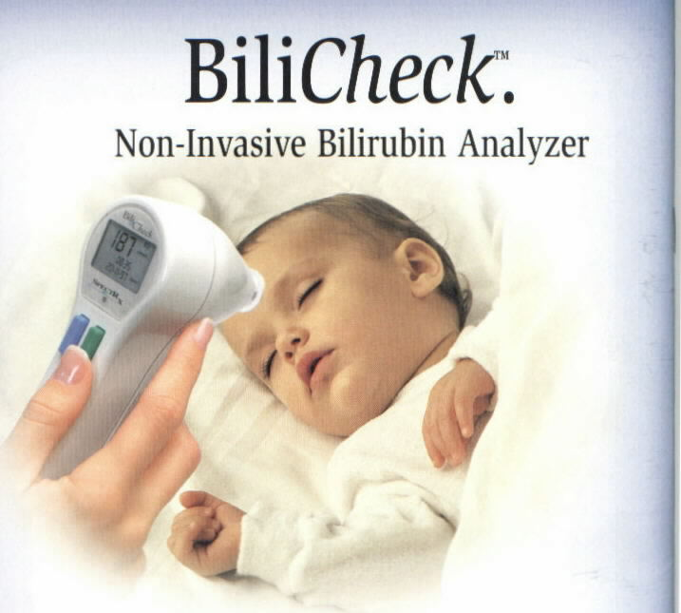
Lab. evaluation
Guided by the clinical setting
Total serum bilirubin (TSB)
  Direct
  Indirect
Transcutaneous bilirubin(TcB)

Slide 34
Lab Evaluation Cont…
Blood type, Rh and Coombs test of the infant
Blood type and Rh of the mother
Complete blood count, smear, and reticulocyte count
Tests for liver disease & enzyme deficiencies
Congenital infection screening
Sepsis work up (cbc, blood &CSF culture etc.
Screen for metabolic defects, hypothyroidism….

Slide 35
Increased
Indirect
Bilirubin
Positive Coombs
Negative Coombs
Hematocrit
Isoimmunization
Rh
ABO
Other
High
Normal or Low
Twin transfusion
Maternal fetal transfusion
Delayed cord clamping
SGA infant
LGA infant

Slide 36
Normal or Low Hematocrit
Reticulocyte Count
Increased
Normal
Smear/RBC Morphology
Characteristic
Spherocytosis
Eliptocytosis
Stomatocytosis
Non-specific
G6PD deficiency
Pyruvate kinase deficiency
Other hereditary enzyme deficiency
DIC

Slide 37
Normal
Extravascular Blood
  Cephalohematoma
  Other hemorrhage
Increased EHC
  Breastfeeding
  Pyloric stenosis
  SBO or LBO
  Swallowed blood
Metabolic-Endocrine
  Cong. glucuronyl trans.deficiency
  Galactosemia
  Hypothyroidism
  Infants of DM mothers
OTHERS
  Infectins(TORCHES,sepsis etc)

Slide 38
Acute Bilirubin Encephalopathy
A neurologic syndrome resulting from the deposition of unconjugated bilirubin in the basal ganglia and brainstem nuclei.
Affects 1/3 of infants with untreated hyperbilirubinemia
2-16% in premature infants
Grave prognosis with overt neurologic symptoms
  75%/more die and 80% of survivors have severe neurologic sequelae

Slide 39
Potentially preventable causes of kernicterus
Early discharge(<48hrs) with no early follow up particularly of near term infants(35-37wks
Failure to check the bil. Level in an infant noted to have jaundice in the 1st 24hr
Failure to recognize risk factors
Underestimating severity by clinical judgment
Lack of concern regarding presence of jaundice
Delay in initiating phototherapy in the face of elevated bil.
Failure to respond to parental concern of jaundice, poor feeding/lethargy

Slide 40
Pathogenesis is multifactorial and involves the interaction of:
  Unconjugated bilirubin level
  Albumin binding & unbound bilirubin level
  Passage across the BBB
  Neuronal susceptibility to injury
Toxic level
  -Unpredictable
  -variable for individual infants and to the
  same infant in d/t settings
  -range 20-50mg/dl

Slide 41
Duration of exposure is also unknown
Rare in healthy term infants if bil level <25mg/dl
The less mature the infant the greater the susceptibility to kernicterus

Slide 42
Factors which increase toxic effects of unconjugated bilirubin
1.reduced retention of bilirubin in circulation
  -hypoproteinemia,
  -displacement of bilirubin from its binding sites on albumin by competitive binding of drugs e.g. sulfonamides
  -acidosis, hypoglycemia, starvation,
  hypothermia
2. Increased permeability of the blood brain barrier/nerve cell membranes to bilirubin OR increased susceptibility of brain cells to its toxicity
  e.g. -asphyxia, prematurity, hyperosmolality and infection

Slide 43
Clinical manifestation
Major Clinical Features of Acute Bilirubin Encephalopathy
Initial Phase
  Slight stupor ("lethargic," "sleepy")
  Slight hypotonia, paucity of movement
  Poor sucking, slightly high-pitched cry

Slide 44
Intermediate Phase
  Moderate stupor—irritable
  Tone variable, usually increased; some have retrocollis-opisthotonos
  Minimal feeding, high-pitched cry
Advanced Phase
  Deep stupor to coma
  Tone usually increased; some have retrocollis-opisthotonos
  No feeding, shrill cry

Slide 45
Chronic form
  First year
    hypotonia, active DTR, and delayed motor skills
  After First year
    Movement disorders
    Choreoathetosis, ballismus, tremor
    Upward gaze
    Sensorineural hearing loss

Slide 46
Management of hyperbilirubinemia
Goals
  Identification of risk
  Prevention of kernicterus
  Treatment of underlying conditions
  Maintenance of hydration and nutrition

Slide 47
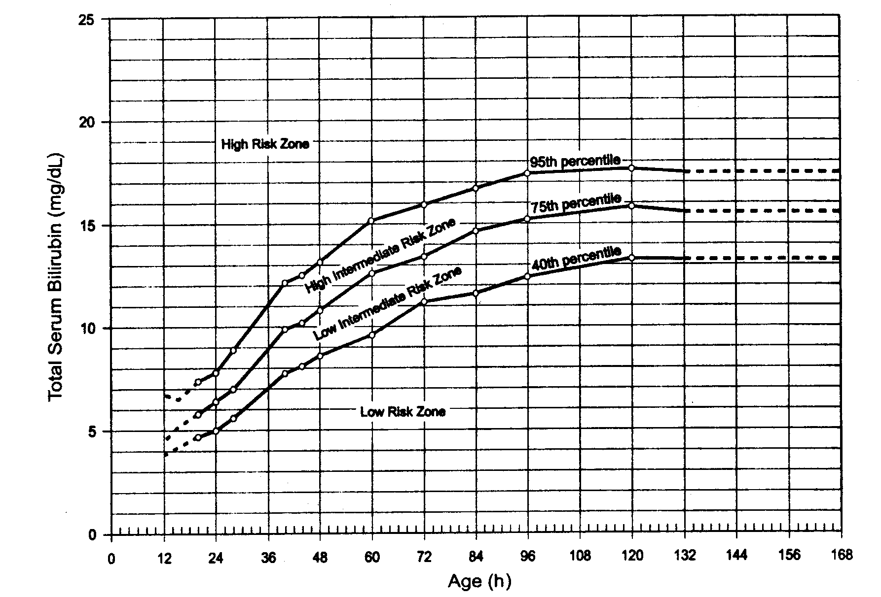
Risk designation of term and near term well newborns based on their hour specific bilirubin values

Slide 48
Percentile-based bilirubin nomogram
High risk zone >95th centile(6.1%)
Intermediate risk(32.1%)
  Upper 75th -95th centile
  Lower 40th -70th centile
Low risk < 40th centile(61.8%)

Slide 49
Interventions
  Intensive Phototherapy
  Exchange transfusion
  pharmacologic agents
    to interfere with heme degradation and bilirubin production,
    accelerate the normal metabolic pathways for bilirubin appearance,
    inhibit the enterohepatic circulation of bilirubin.

Slide 50
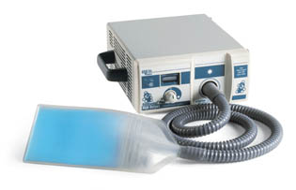
Phototherapy
Given by exposing the infant to a high intensity of light in the visible spectrum
Bilirubin absorbs light maximally in the blue range, however broad-spectrum light source can be used.
Fiberoptic phototherapy

Slide 51
Phototherapy works by infusing discrete photons of energy similar to the molecules of a drug.
These photons are absorbed by bilirubin molecules in the skin and subcutaneous tissue, just as drug molecules bind to a receptor.
The bilirubin then undergoes photochemical reactions (isomerization) to form excretable isomers and breakdown products that can bypass the liver’s conjugating system and be excreted without further metabolism.
Some photo products also are excreted in the urine.

Slide 52
CONT..
The absorption of light by normal bilirubin (4Z,15Z-bilirubin) results in the creation of 2 isomeric forms of bilirubin:
1.structural isomer, irreversible= bilirubin is Z-lumirubin
2. configurational isomers, reversible = bilirubin is 4Z,15 E -bilirubin.
Both the configurational and structural isomers of bilirubin are less lipophilic than normal bilirubin and can be excreted into bile without undergoing glucuronidation in the liver.

Slide 53
Cont…
Some of the configurational isomers of bilirubin, however, revert back to the native form after excretion into bile and can be reabsorbed via enterohepatic circulation in the gut.
Structural bilirubin isomers, like Z-lumirubin, can also be excreted in the urine.
3. photo oxidation : the generation of excited-state bilirubin molecules that react with oxygen to produce colorless oxidation products, or photooxidation products.
This process occurs more slowly than configurational or structural isomerization, primarily excreted in the urine.

Slide 54
Cont…
Technique
  Light source
    spotlights, fiber optic blankets, special blue,white, blue, green
    wave length: 420-470nm
  Positioned 15-20cm above infant
  Largest surface area possible exposed
  Intermittent vs. Continuous: current evidence does not allow recommendations

Slide 55
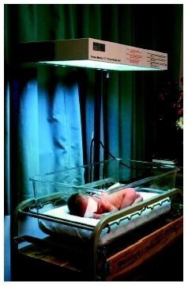
Cont..
Indications
  Pathologic jaundice
  Prophylactic in VLBW infants

Slide 56
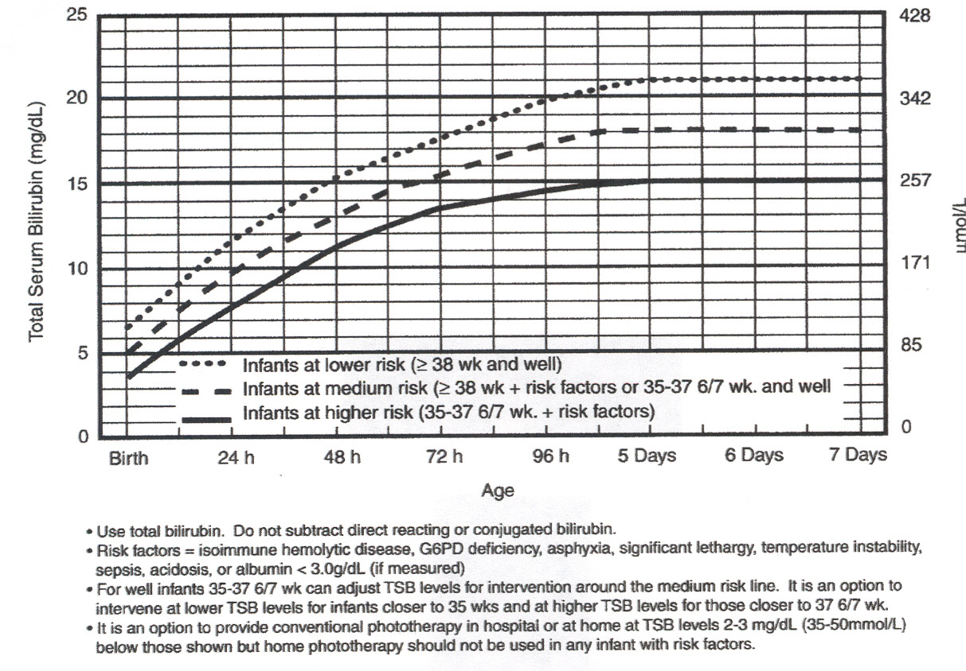

Slide 57
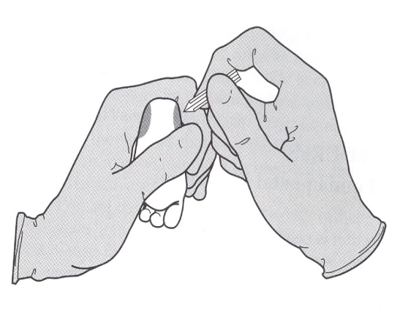
Phototherapy Precautions
Ensure patent airway
Maintain constant body temperature by using incubator and Neutral Thermal Environment.
Assess temperature every 4-8 hours
Maintain fluid balance by increasing intake and minimizing loss (insensible, respiratory, GI)
Cover eyes and genitalia

Slide 58
Phototherapy Precautions
Assure skin integrity
  frequent diaper changes
  water baths
  no lotions or oils on skin
  position to avoid skin irritation
Careful technique when repeatedly drawing labs
  Consider use of automatic lancet
  Warm foot before procedure
  Avoid areas of previous puncture

Slide 59
Complications of Phototherapy
Dehydration
  increased insensible water loss
  loose stools
Irritability or lethargy
Skin rashes
Overheating
Retinal injury

Slide 60
Cont….
Tanning/Bronze Baby Syndrome
  Dark grayish discoloration of skin
  Occur in infants with significant elevation of direct-reacting bilirubin
  Due to photo induced modification of porphyrines
  May last for many months
Long term sequele are absent/minimal/unrecognized

Slide 61
Exchange Transfusion
Indications
Intensive phototherapy failed to reduce bilirubin to a safe level and risk of kernicterus greater than risk of the procedure.
Infant has signs of kernicterus

Slide 62
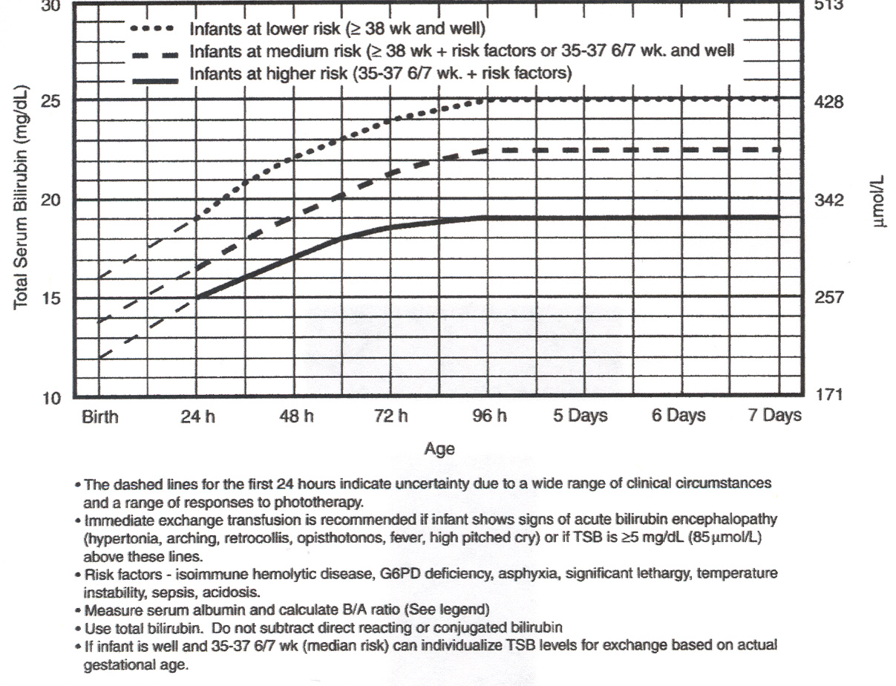
Indication in infants 35 weeks gestation or more

Slide 63
Complications
  Thrombocytopenia
  Portal vein thrombosis/perforation
  Necrotizing Enterocolitis
  Cardiac arrythmias, volume overload
  Hypo- Calcemia, magnesemia, glycemia
  acidosis
  Respiratory & metabolic accidosis
  HIV, Hepatitis B & C infection
  Graft vs host disease
  Death

Slide 64
Weight(gm) | Phototherapy | Exchange tranfusion
500-1000gm | 5-7mg/dl | 12-15mg/dl
1000-1500gm | 7-10mg/dl | 15-18mg/dl
1500-2500gm | 10-15mg/dl | 18-20mg/dl
>2500gm | >15mg/dl | >20mg/dl
HARRIET LANE

Slide 65
Pharmacologic Treatments
Phenobarbital
  Accelerates metabolic pathways for bilirubin clearance
Tin-mesoporphyrin
  inhibits heme oxygenase
IV gamma globulin
  inhibits hemolysis
Act. Charcoal
  binds bili in the intestine decreased E-H circulation

Slide 66
Follow-up Care
Plan based on
  Age in hours at discharge
  Risk of excessive hyperbilirubinemia
  Availability and reliability of follow-up
Components
  Written discharge instructions regarding hyperbilirubinemia, breastfeeding, dehydration
  Time specific appointment based on age in hours at discharge and risk factors
    Infant < 24 hours old: should be seen by 72 hours of age
    Infant between 24-47.9 hours old: seen at 96 hours of age
    Infant between 48-72 hours old: seen at 120 hours of age
    Infant >72 hours old at discharge: physician’s discretion
  Follow-up resources for lactation support

Slide 67
The 10 Commandments for Preventing and Managing Hyperbilirubinemia
1. Promote and support successful breastfeeding.
2. Establish nursery protocols for the jaundiced newborn and permit nurses to obtain TSB levels without a physician’s order.
3. Measure the TSB or TcB concentrations of infants jaundiced in the first 24 h after birth.

Slide 68
4. Recognize that visual diagnosis of jaundice is unreliable, particularly in darkly pigmented infants.
5. Interpret all TSB levels according to the infant’s age in hours, not days.
6. Do not treat a near-term (35 to 38 wk) infant as a term infant; a near-term infant is at much higher risk of hyperbilirubinemia..

Slide 69
7. Perform a predischarge systematic assessment on all infants for the risk of severe hyperbilirubinemia.
8. Provide parents with information about newborn jaundice.
9. Provide follow-up based on the time of discharge and the risk
assessment.
10. When indicated, treat the newborn with phototherapy or
exchange transfusion.

Slide 70
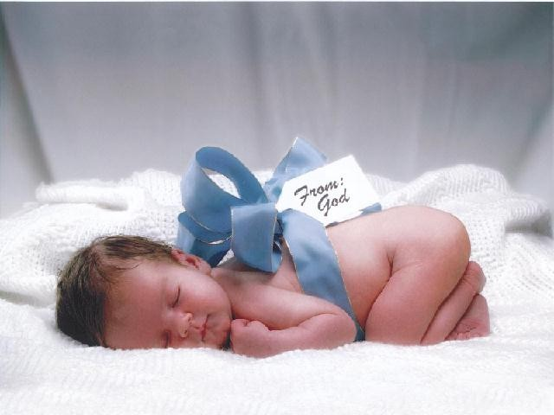
Thank you !!

Slide 71
References
Nelson Textbook of Pediatrics 21st Edition .
Cloherty and Stark's manual of neonatal care 9th edition(2021).
Fanaroff & Martin’s Neonatal-Perinatal Medicine diseases of the fetus and infant 11th Edition.
UpToDate 2023
Gomella’s Neonatology 8th Edition (2020).

